Slide 1

Spring Cloud Routing
Mapping Services using Intelligent Routing

Slide 2
Outline
Routing in Cloud Native App
Netflix Zuul
Proxy Server
Setting up routes
Setting up Filter

Slide 3
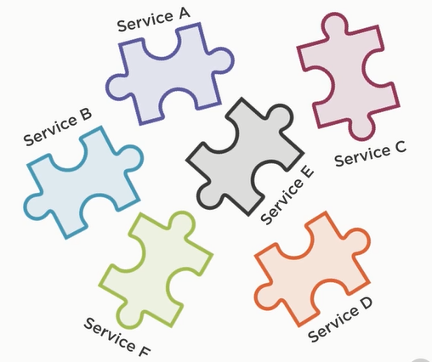
Individually Deployable Service
In order to be as dynamic and scalable as possible , A cloud native system is made up of individually deployable services , which together as a whole form the overall system

Slide 4
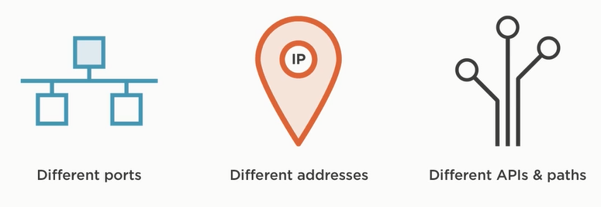
Challenges with Individual Service
Each of those individual services may be running on a different port, different address, or a combination of both and they also likely to have different API & Paths to interact with.

Slide 5
Challenges with Individual Service
As a client ( such as mobile or web), Interacting with each individual service would be a disaster.

Slide 6
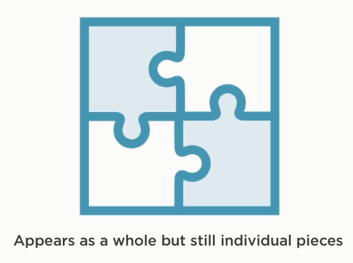
The Solution: Intelligent Routing

Slide 7
Intelligent Routing: Using Gateway Service
Routing is typically implemented via something called a Gateway Service / API Gateway.
Gateway Service / API Gateway
... a single entry point for all clients ...

Slide 8
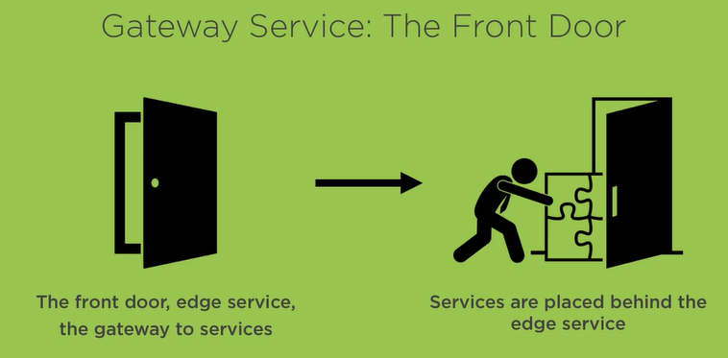
Intelligent Routing: Using Gateway Service

Slide 9
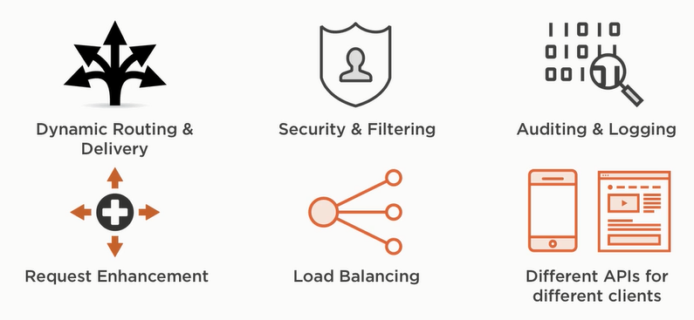
A Gateway Service Provides

Slide 10
A Gateway Service Provides
The Gateway service not only provides Dynamic Routing and Delivery, which means at Runtime it can decide where to route a request and if it should even route the request at all.
But it also provides an array of other functionalities.

Slide 11
A Gateway Service Provides
Security & Filtering
It provides the ability to authenticate all of the incoming request as well as filter out any short of illegitimate or bad request.
Auditing & logging
Since all the request enter through the Gateway.
Request Enhancement
Which means, it can add additional information to the request or enrich the request.
Load Balancing
Can act as a load balancer for the individual services behind it
Different APIs for Different Clients
APIs are not a one size fit all kind of thing, different client such as web client / mobile client have different need in the way they call your API.

Slide 12
Intelligent Routing: Using Spring Cloud & Netflix ZUUL
Netflix ZUUL
Zuul is a gateway service that provides dynamic routing, monitoring, resiliency, security and more.

Slide 13
Using Spring Cloud & Netflix ZUUL
Create spring starter project
Name :
gateway-service
Dependencies :
zuul , discovery-client, devtool , actuator
Main class
@EnableZuulProxy

Slide 14
Using Spring Cloud & Netflix ZUUL
From a configuration standpoint you have 2 different options.
Configure Gateway service to use Service discovery
Configure Gateway service without Service discovery

Slide 15
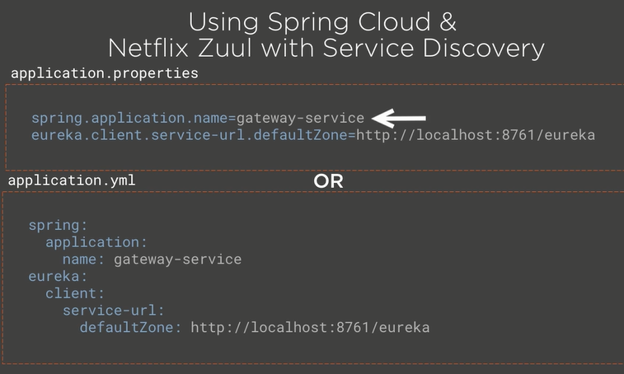
Netflix ZUUL

Slide 16
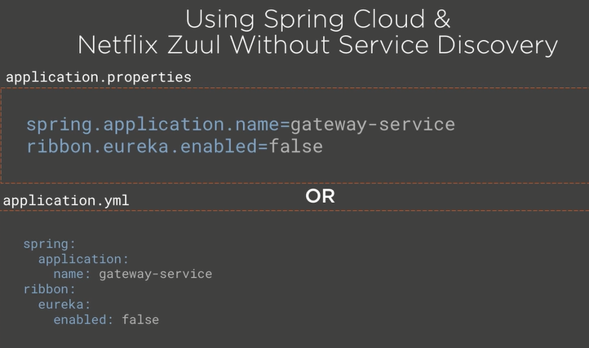
Netflix ZUUL
zuul.ribbon.eager-load.enabled=true

Slide 17
Configuring Routes with Spring Cloud & Netflix Zuul
Once everything is configured, The next step is to define how zuul should route request.
The default routing behavior when zuul is setup using service discovery is to route request by service name.

Slide 18
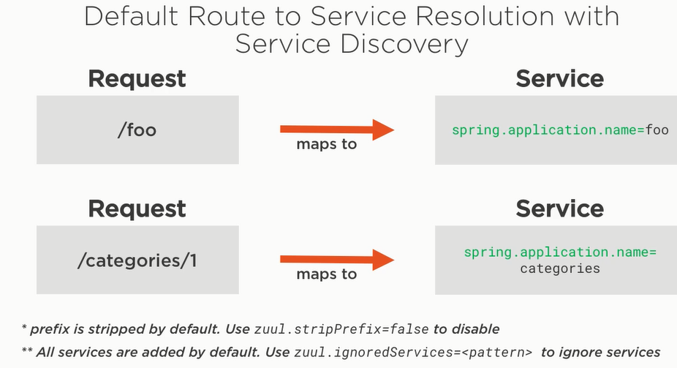
Netflix ZUUL

Slide 19
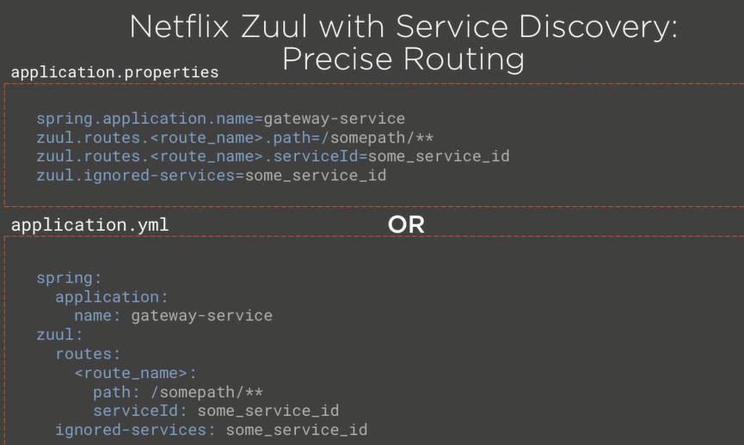
Netflix ZUUL

Slide 20
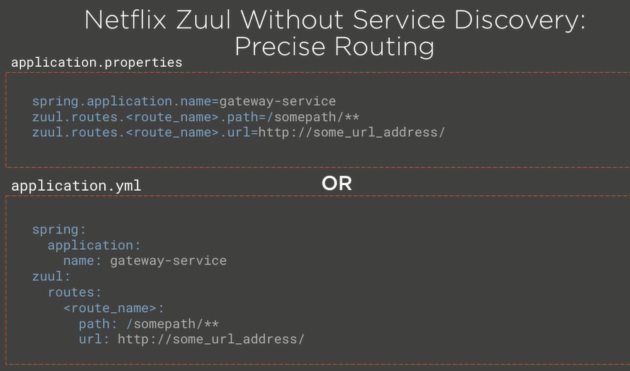
Netflix ZUUL

Slide 21
Example
Gateway-service
Dependencies
Zuul , Eureka Discovery
@EnableZuulProxy
@EnableDiscoveryClient
Hello-service
Dependencies
Web , Eureka Discovery
@EnableDiscoveryClient
Goodbye-service
Dependencies
Web , Eureka Discovery
Service discovery ( Optional )

Slide 22
Creating Filters with Spring Cloud & Netflix Zuul

Slide 23
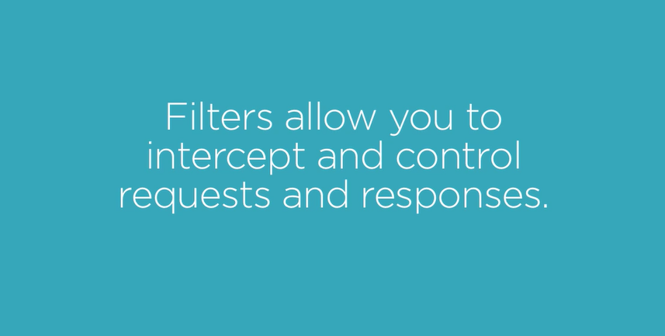

Slide 24
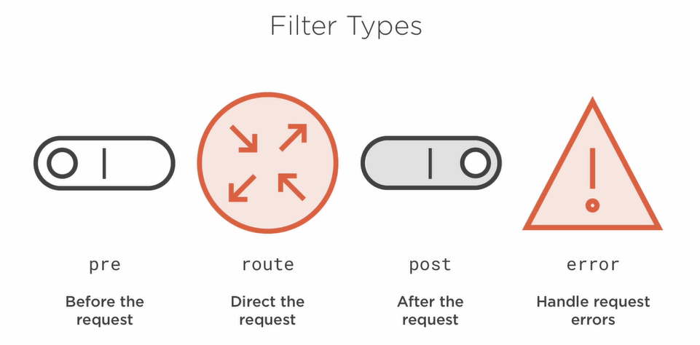

Slide 25
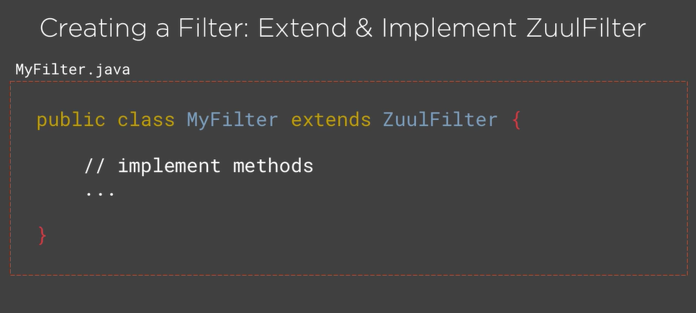

Slide 26
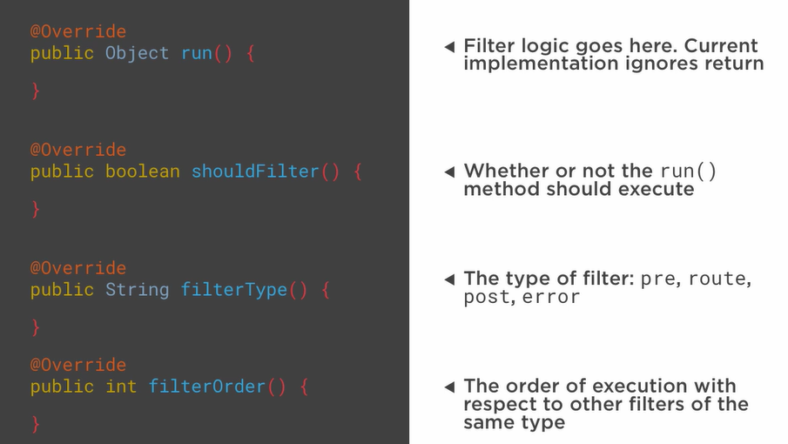

Slide 27
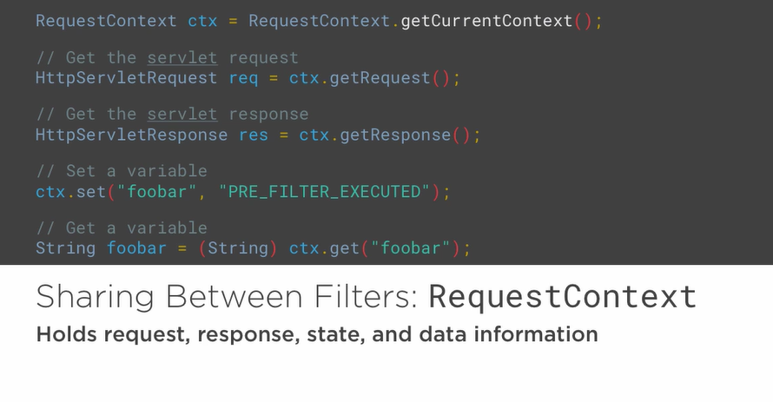

Slide 28
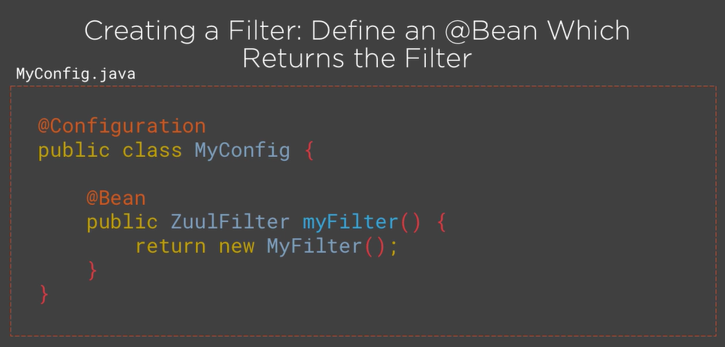

Slide 29
Gateway-service
public class AddRequestHeaderFilter extends ZuulFilter{
public boolean shouldFilter(){
return true;
}
public String filterType(){
return "pre";
}
public int filterOrder(){
return 0;
}
public Object run(){
RequesContext ctx = RequestContext.getCurrentContext();
ctx.addZuulRequestHeader("x-location","USA");
return null;
}
}

Slide 30
Gateway-service
@Bean
public AddRequestHeaderFilter addRequestHeaderFilter(){
return new AddRequestHeaderFilter();
}

Slide 31
hello-service
@RequestMapping
public String hello(@RequestHeader("x-location") String location){
return "Hello from "+location;
}

